Slide 1
Midterm
Waner Li

Slide 2
Project Statement
A dreamy outdoor scene with numerous small islands float on the water and surrounded by clouds. These islands are covered with strange but beautiful plants, and peculiar creatures houses scattered across them. Drifting along the river with a swing, one can enjoy the surreal landscapes along the way.

Slide 3
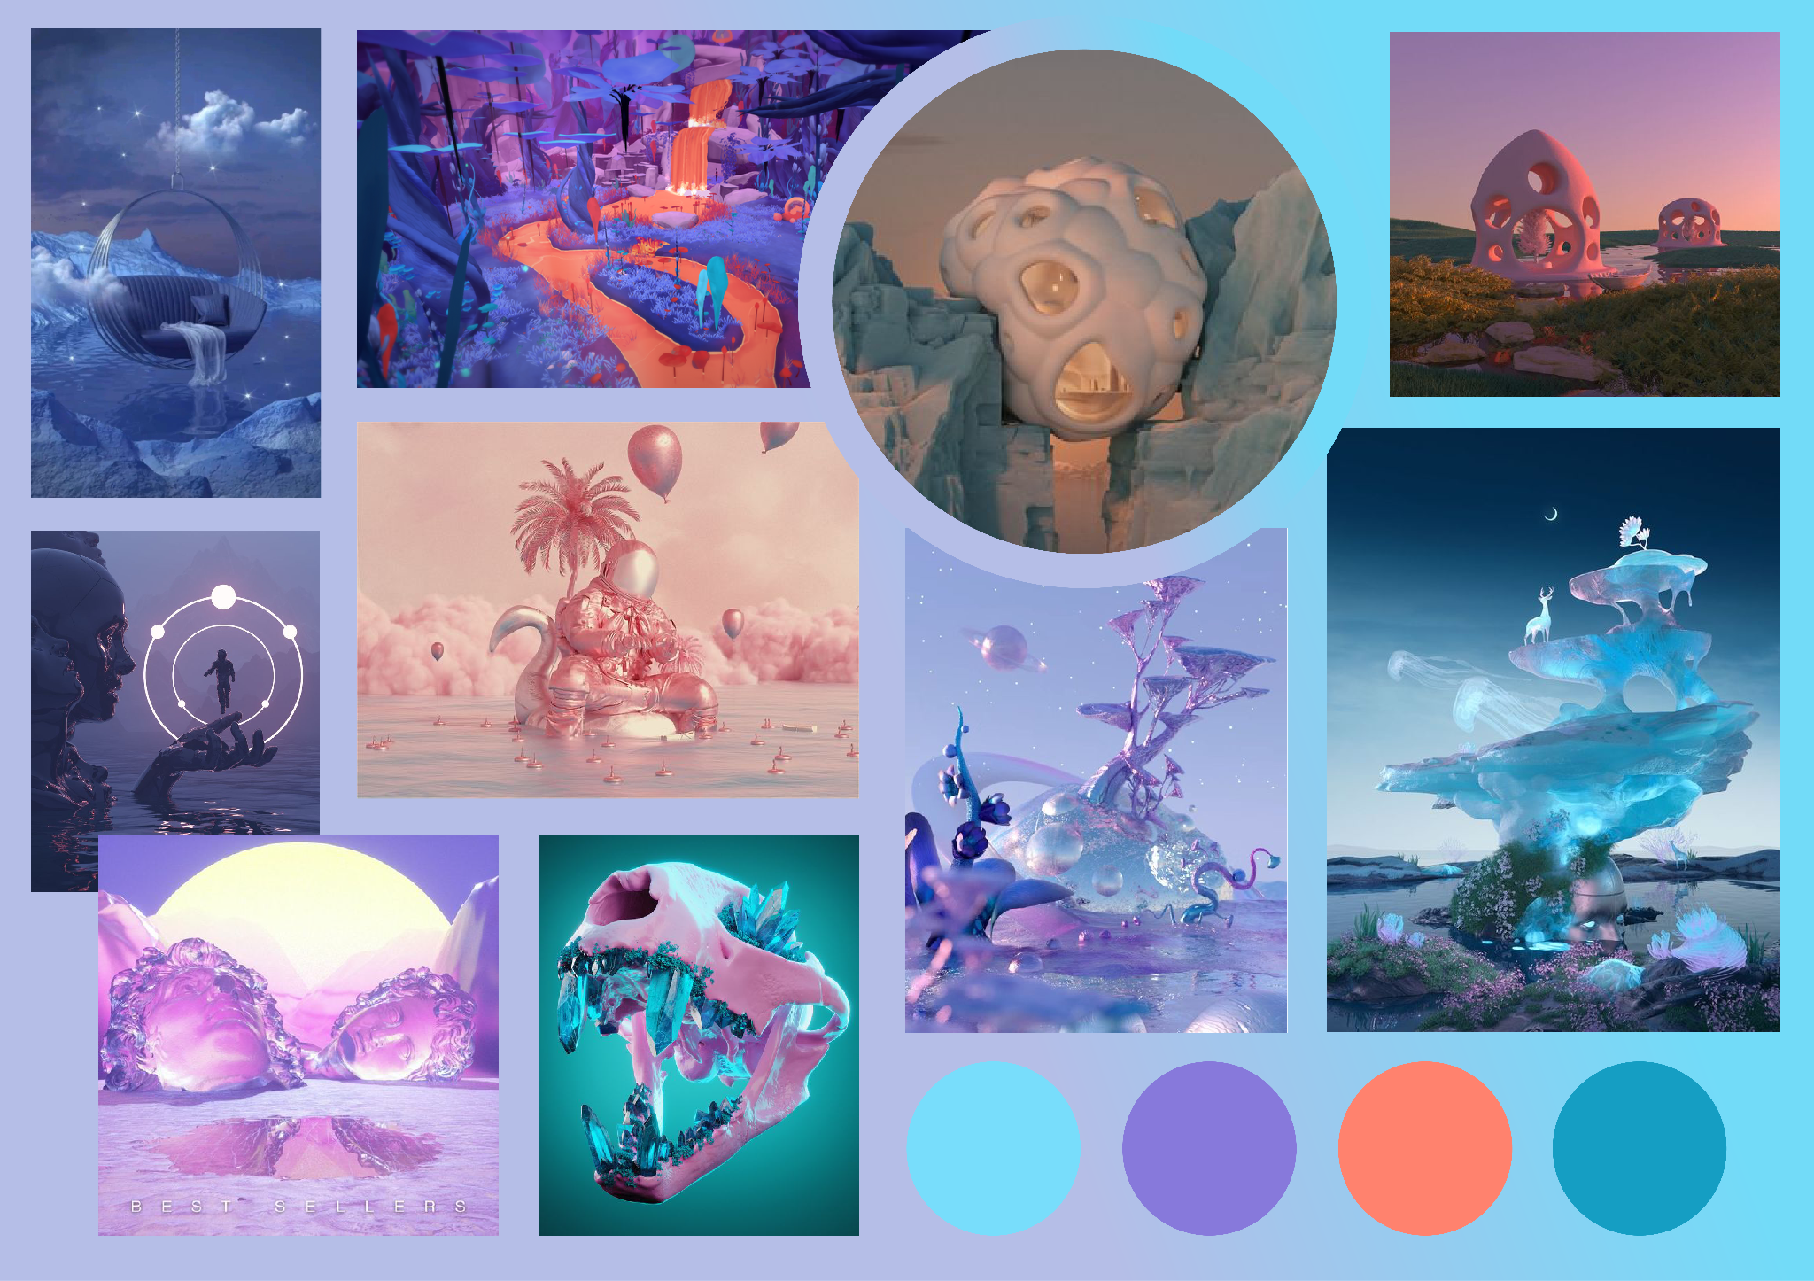
Inspiration and Moodboard
Swing(which can float on the river)
Weird plants and buildings
Island on water
Crystal like material

Slide 4
Referencing Tutorial
Water: https://youtu.be/sozlex6OGRg?si=Ou8r4Ow2eJMz9w6i
Cloud: https://youtu.be/mBO0H1gvz5M?si=8MuZ_LBdr20Xwcj1
Crystals: https://youtu.be/gaV7bD0ImPM?si=PDyu-1AGniLxfFlq

Slide 5
Technical Workflow & Timeline
Modeling | 2/29-3/10
Texturing | 3/10-3/13
Layout | 3/13-3/15
Lighting | 3/15-3/17
Animation | 3/17-3/18
Rendering | 3/18-3/19

Slide 6
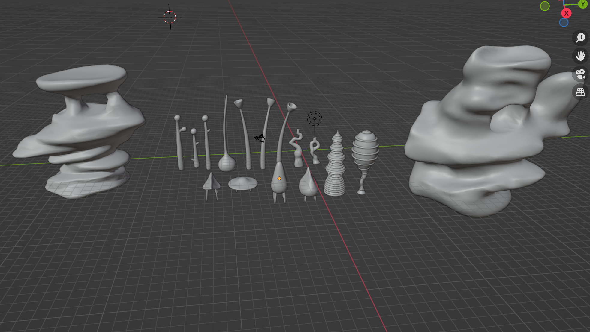
Progress So Far

